Slide 1
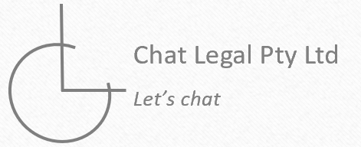
Estate Planning

Slide 2
House keeping
Recording
Full names, correct spelling and pronunciation
Worthwhile details to be aware of
Intentionally ‘non-technical’, but ask if you are curious
Non-relevant slides skipped
Complex estates
Please feel free to ask any questions at any point.

Slide 3
Overview
About you and your objectives
How can we achieve your objectives
Documents and advice
Our goal is for you to walkaway with a largely completed estate plan and an understanding of any additional steps you that may need to be actioned.

Slide 4
Vocabulary
Here are some ‘legal’ terms that may be used today:
Legal personal representative – Person(s) who represent you
Executor – Person(s) who are responsible with ensuring your Will is followed through
Guardian – Person(s) responsible for making decisions for any minor children
Trustee – Person(s) who are holding and managing assets for the benefit of other people
Appointor – Person(s) who can change the trustee
Director – Person(s) who make decisions for a company
Shareholder – Person(s) who own the company and decides the directors
Attorney – Person(s) who makes personal or financial decisions on your behalf

Slide 5
About you and your objectives
1

Slide 6
Family and key persons
Please provide me with the following information in relation to your immediate family, people you want to benefit from your Will and key persons for your ‘Will’:
Full names and other names they go by
Relation to you (including if ‘step’ or ‘adopted’)
Your relationship with that person (great, good, alright, estranged)
Details of age and place of residence
Other details to be aware of including their health, their occupation or past history
The information provided here will outline if there are estate planning issues to be aware of including but not limited to: estate challenges, if ‘special’ strategies should be employed and if your intentions need amending.

Slide 7
Family tree
Parents details of Individual 1
Full name (relationship, age)
Parents details of Individual 2
Full name (relationship, age)
Full name
Age
Job
Health
Full name
Age
Job
Health
Sibling details/broader family of Individual 1
Full name (relationship, age)
Sibling details/broader family of Individual 2
Full name (relationship, age)
Children details
Full name (age, blood/adopted/step, occupation)

Slide 8
Assets and liabilities
Please provide me with the following information in relation to significant assets or debts that you own (whether directly or indirectly)
Specific details about asset including who legally owns
Market value, debt linked to assets and approximate equity
Who to benefit from the asset including if there are particular ‘directions’
Where is the asset located
Depending on how your asset is held and who you would like to benefit, it may either be easily done, or potentially complicate your affairs (because it cannot be easily achieved).

Slide 9
Structure diagram
Personal
Trust and companies
Superannuation
Individual 1
Property
Bank a/c
Shares
Personal assets
Car
Liabilities
Property
Bank a/c
Shares
Individual 2
Property
Bank a/c
Shares
Personal assets
Car
Liabilities
Property
Bank a/c
Shares
Entity
Member 1
Balance:
Insurance:
Member 2
Balance:
Insurance:
Joint assets
Property JT/TIC

Slide 10
Your objectives
In your own words
Who do you want to benefit from your assets
Who do you want to be in charge of those assets (relevant if benefiting persons are minors)
(If applicable) Who do you want to look after any minor children
Are there particular people you do not want benefiting from your assets?
Consider different alternatives, scenarios and backups.

Slide 11
How can we achieve your objectives
1

Slide 12
Passing assets
There are various factors that can impact how assets can pass
Who owns the asset: you personally, your superannuation, you jointly with another, a company, a trust, a partnership (through one of the other methods)
How does the asset pass: transferring the asset directly into the name of the intended beneficiary or giving control over the asset to the intended beneficiary
Are there other factors that can impact the above: the potential for your Will to be challenged or the need to be rigid in how you pass the asset (e.g. the succession of a business)
It is important to appreciate that having assets held in different manners – such as jointly with other people, through trusts and through companies – will impact what needs to be done. A Will might not be enough!

Slide 13
Summary table
Ownership | What governs | What to look for | How to pass asset
Personal | Will If no Will – the law | N/A | Direct or control
Superannuation | Superannuation document and beneficiary nominations | Has a ‘beneficiary nomination’ been made and is it binding? | Direct, and if ‘SMSF’ – control
Jointly | Either the law, or how the joint interest is owned | Joint tenants or tenants in common | Depends on how owned
Company | Company constitution Legal owner of share | Who is the director or shareholder | Control
Trust | Trust document If unsure, trust law | Who is the trustee or appointor (controller) | Control
Partnership | Depends on how owned and third party agreements | Depends on how owned | Depends on how owned

Slide 14
Estate challenges
Family provision application
Eligible person able to challenge – generally includes spouse, children and people dependant on you which can include parents, ex-spouses and people who you provide maintenance to)
Prove not adequately provided for – based on various factors:
Only affects assets going into your Will – except if assets held in NSW

Slide 15
Estate challenges
Factors a Court considers in determining if an eligible person is adequately provided for:
Financial position of eligible person and needs now and into the future
Ability for eligible person to meet financial obligations
Physical, intellectual or mental disability of eligible person
Size of estate
Contributions made by eligible person to deceased’s estate or deceased’s welfare
Competing claims from other beneficiaries
Standard of living of the eligible person during deceased’s lifetime
Relationship between deceased and the eligible person
Wishes of the deceased

Slide 16
Estate challenges
Other ways to challenge
Will leaving markings suggesting ‘tampering’ or ‘missing pages’
Invalid Will (not executed properly)
No capacity to make Will (unable to properly understand what is being signed)
Promises made to a person not kept in Will

Slide 17
Estate challenges - strategies
Making provision
Bypassing your Will
Joint tenancies
Direct superannuation nominations
Separate successor control documents
Restructuring
Gift and loan back arrangements
Call options
Declarations (formal or informal)
Roll the dice and let the Court decide

Slide 18
Superannuation
Not automatically part of your Will
Power to nominate recipients – ‘legal personal representative’, spouse, children or dependents
Nominations can be binding or non-binding
Retail or industry funds – you can do it yourself
SMSF – a lawyer should do it for you to review any governing documents and follow the procedure and consider the control mechanisms
If SMSF – story time
To avoid all doubt, you should consider preparing a nomination to confirm what happens to your superannuation benefits. If you make this nomination binding, there is no room for ambiguity or dispute.

Slide 19
Jointly held assets
Joint tenants (think ‘joined by the hips’)
Rule of survivorship – each person owns 100% (from succession perspective)
Death of co-owner means surviving co-owner automatically receives asset
Tenants in common
Each co-owner owns a specific percentage in an asset (e.g. 50%, 99%)
All percentages add up to 100%
Death of co-owner means that deceased’s share goes into their Will
It is important to appreciate that assets can be held jointly in different ways. It also needs to be considered if it is better for any assets you hold jointly with another, to be held in one manner over another.

Slide 20
Trust assets
Assets in a trust is not yours
There is a document (trust deed) governing the rules of the ‘trust’
Those rules dictate who can benefit – it is not for your Will to override those rules by default
Question becomes who controls the trust
As there is already a set rule book, if your intentions are contrary to the rule book, complicated changes need to be made
The rule book needs to be reviewed
Assets held in trusts normally pass through the ‘gifting’ of control. By giving control to the relevant person(s), that person(s) can decide how to deal with the assets in the trust.

Slide 21
Company assets
Assets in a company is not yours, a company does not pass away with you
There is a document (constitution) governing the rules of the company
The directors enforce the rules and makes the decisions
Shareholders ultimately benefit from any retained assets in the company and can dictate who the directors are
The rule book for the company, however, needs to be reviewed to see if it states what happens
If there are multiple shareholders, then any ‘shareholders agreement’ also needs to be considered
Assets in a company stays in the company if you pass away. The question, however, is who becomes the shareholder for the company.

Slide 22
Business and partnerships assets
Depending on the different ways you own assets in a business or partnership, you will need to consider those relevant estate planning issues
Also, however, given you are dealing with other persons, you should consider what happens if a key person passes away.
To respect your partner/s, they should also be part of the discussion and all in agreeance.
Additional documents will be required (shareholders/unitholders agreements, partnership deeds and/or buy sell deeds)
As there are multiple ‘unrelated’ persons involved, any discussion in relation to the succession should be discussed with all parties.

Slide 23
Overseas assets/beneficiaries
Get a Will in that Country!
Consider tax issues if there are overseas beneficiaries (CGT event K3)

Slide 24
Other issues
Funeral arrangements
Digital assets (pas sunder Will or licence only)
Cryptocurrencies
Loan accounts
Liabilities and personal guarantees
Life interests
Binding financial agreements
Other agreements
Mutual Wills

Slide 25
Flexibility
How flexible do you want to leave things?
The more ‘set in stone’, the more complicated it is to implement
War stories
Practical examples (too particular to a detriment and controlling the uncontrollable)
Potential alternative – a guideline document?
Trusting people
If untrustworthy, keep things simpler, appoint more people or include independent persons?
We have discussed giving assets directly compared to passing control. There are benefits in passing control, but also disadvantages.

Slide 26
Flexibility – questions to consider
Do you want to leave some ‘guidelines’ or ‘rule beyond the grave’?
If ruling beyond the grave, we will simplify things to remove any potential for abuse of power.
If leaving some ‘guidelines’, do you trust those in control to not abuse their power?
Think – if the persons in control could take all the assets for themselves, do I trust them not to?
Should I appoint multiple people or an independent person(s)?
Importantly, do I trust those in control to consider my guidelines and act in the best manner possible?
This ‘guideline’ document is called a ‘memo of directions’, and we provide you with a template to complete at your leisure.

Slide 27
Memo of directions
This document allows you to document your intentions and guidelines
It could be a blank piece of paper, or the template that we provide you
It allows you to outline your thought process without fear of making things too restrictive with wording able to be ‘lax’ and personal
Those looking after your affairs will at least then have a document that they can refer to when looking after your affairs
It allows you to leave some non-binding directions so those in control can administer things per your intentions or administer things in a different manner if your directions are not appropriate at the relevant juncture (we are not mind readers and do not know what the future entails)
Keep a signed copy of this document with your Will and potentially circulate it to the key persons if you wish as well for their information.

Slide 28
Will
Two general types of Will
‘Simple’ Will – gives assets that goes into your Will directly to people (maybe with some conditions attaching)
‘Testamentary trust’ Will – gives chosen assets that goes into your Will into a special structure that can be utilised for the benefit of a range of people – it offers various added benefits in exchange for a more complex arrangement
We will discuss the advantages and disadvantages of each approach and recommend what should be suitable for you

Slide 29
What is a testamentary trust
A ‘trust’ is a relationship where:
somebody legally (called the trustee)
holds something (assets in the trust)
for others’ benefit (called the beneficiaries)
‘Testamentary’ just means that it is created on after you pass away (and therefore the assets of this trust are assets that form part of your Will)
Lasts for 80 years in all Australian jurisdictions other than South Australia
If you do not ‘get’ the concept after these slides, let me know as this structure will not be suitable for use.

Slide 30
To ‘testamentary trust’ or not

Slide 31
Protection of testamentary trust
At law, the greater the divide between the trustee and beneficiary, the stronger the protection
Impossible to structure correctly without predicting the future
At least including an initial set up in Will allows recipients to restructure at the appropriate juncture
If there is a known threat, then we can structure the testamentary trust
Again, the less control beneficiaries have, the greater the protection
Family law case - Bernard

Slide 32
Benefits and disadvantages
Advantages | How | Disadvantages
Asset protection | People who may be sued do not receive assets in their name | Concept can be difficult to understand
Flexibility and control over succession | There are mechanisms to allow control to be passed down in various ways | More thought required when preparing your Will
Tax planning opportunities | Ability to distribute to a range of people (including minors at adult tax rates) | Tax can be tricky to understand
Reduce potential future transaction fees | Potential tax exemptions available (as of date of this presentation) | Ongoing administration costs once created

Slide 33
When to have a testamentary trust?
Immediately | On death of both of you
Want spouse to utilise benefits of a testamentary trust | Spouse has no need for any of the testamentary trust benefits
Spouse will receive substantial assets under estate ($400,000+) | Lack of assets will form part of your estate
Useful if there are minors able to benefit | No minors around and no need to have ability to distribute to adult children

Slide 34
How many testamentary trusts?
Single | Multiple
Unable to clearly split assets | Ability to clearly split assets between different trusts
Commonly used when benefiting minors (no need for minors to have separate trusts) | Beneficiaries have increased autonomy
Beneficiaries are able to work together | Beneficiaries are unable to work together
Want for a greater sense of purpose | Beneficiaries have separate personal risk/tax profiles
Simpler as only one trust required to be administered | Sufficient assets able to form part of estate ($400,000 per trust at least)

Slide 35
Your estate plan and our advice
1

Slide 36
Personal assets - Will
Contemplation of marriage or divorce?
Will governs Australian assets or includes assets wherever located?
Testamentary trust used?
Executor?
Guardian (if necessary)?
Specific gifts?
Personal property?
Everything else?

Slide 37
Personal assets – testamentary trust
How many?
Primary beneficiary?
Beneficiaries?
Trustee?
Appointor?
Special rules (if memo of directions not enough)?
Standard discretionary trust terms otherwise
Myths – bloodline trusts, asset protection and family law breakdowns – best protection is to separate control from beneficiaries (independent controller?)

Slide 38
Enduring power of attorney
While living
Personal/health – minor in scope
Financial – broad in scope and immediately or loss of capacity
Advance health directive
Multiple attorneys – jointly, severally, by majority or some other combinations?
Backups?
Property in different States

Slide 39
Advice in relation to other assets
Superannuation
Joint assets
Trusts
Companies
Broader entity advice – financial statements, governing document review and entity power of attorney
Business/partnership assets
Overseas assets
Estate challenge strategies
Recommendations documented via a ‘to-do’ list

Slide 40
When to update your arrangements
Change of name
Mentioned person(s) dying or suffering a disability
Changes in relationship status to anyone named in the Will
Changes to your personal circumstances with certain people (i.e. being estranged with people)
Wanting a mutual Will
If you would like changes to the structure or gifts under your Will
Buying property jointly with others and not understanding what happens to the property on your passing
Establishing new structures where you do not know how control passes

Slide 41
Next steps
Draft Will and enduring power of attorney
To Do List prepared
Summary of terms included in cover letter
Second meeting to explain documents and answer queries or make additional changes
Note any further items in To Do List may still need to be actioned

Slide 42
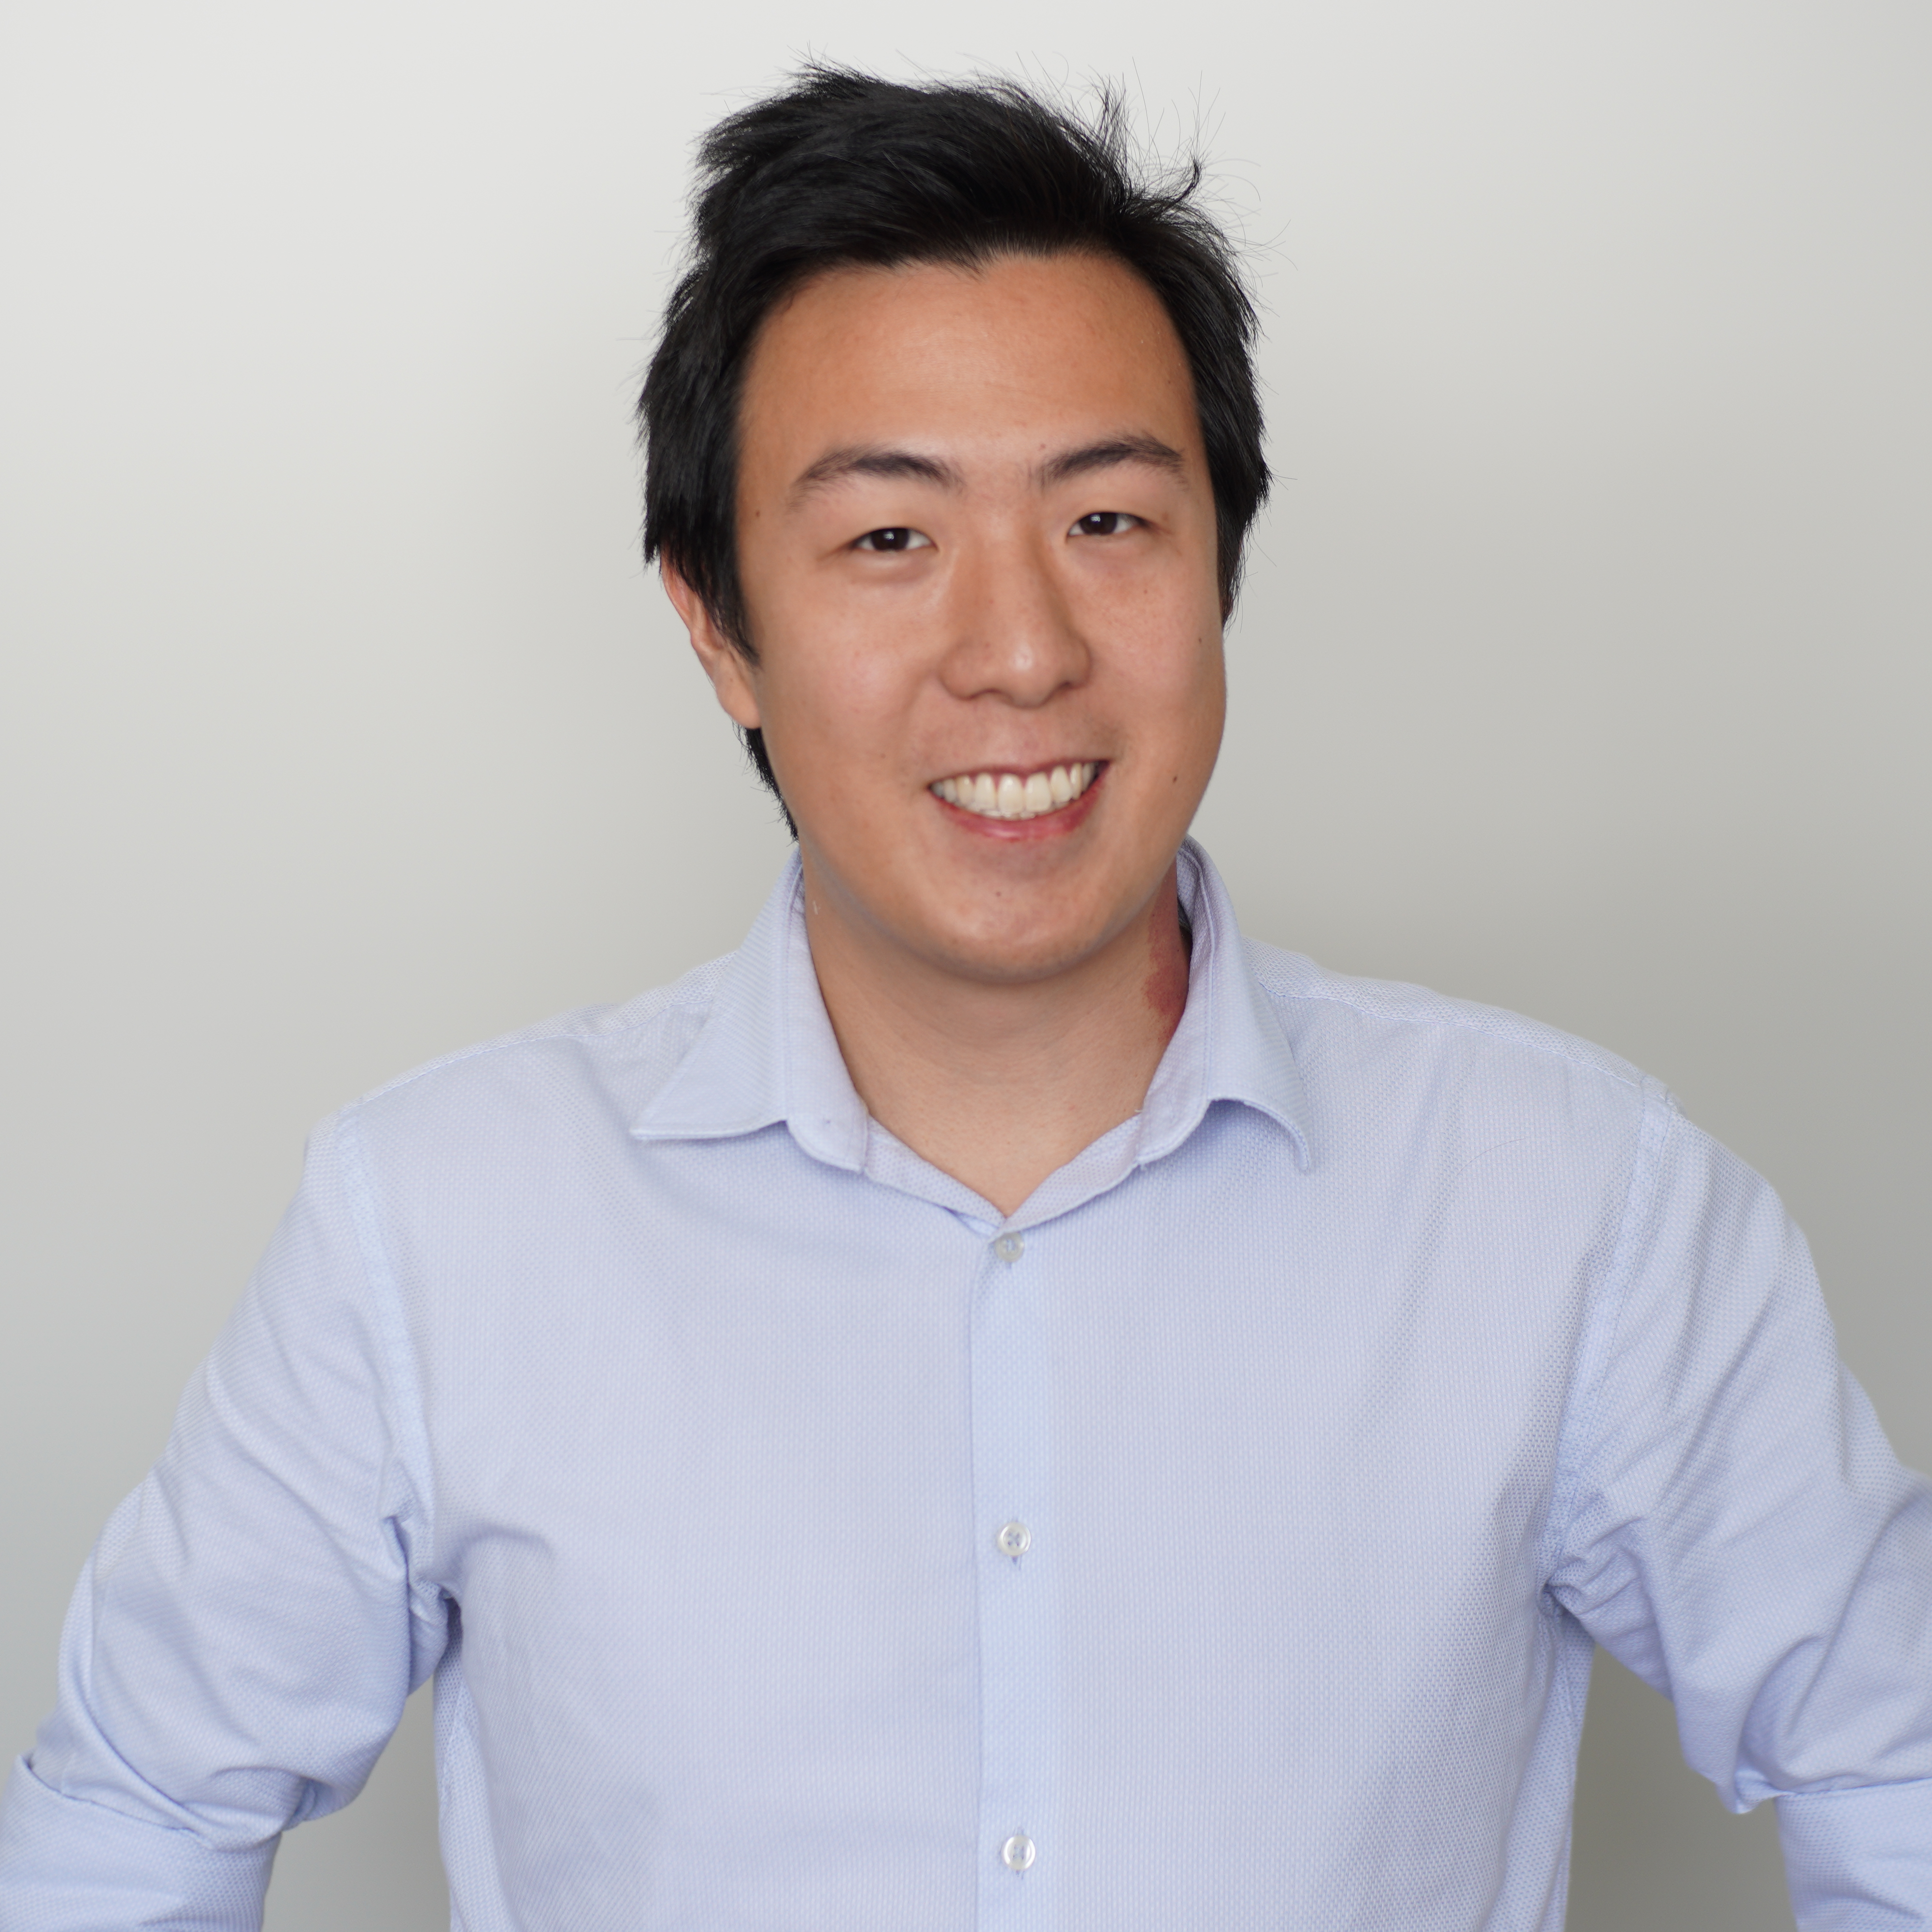
Contact details
Darius Hii, CTA
Director, Chat Legal Pty Ltd
Phone: 0403923374
Email: darius@chatlegal.com.au
Address: Level 6, 200 Adelaide Street, Brisbane, QLD 4000

